Slide 1
Medical Advisory Panel (MAP) Meeting
TA INFL Update
  Saskia Kind /Helen Tao | May 15th, 2025

Slide 2
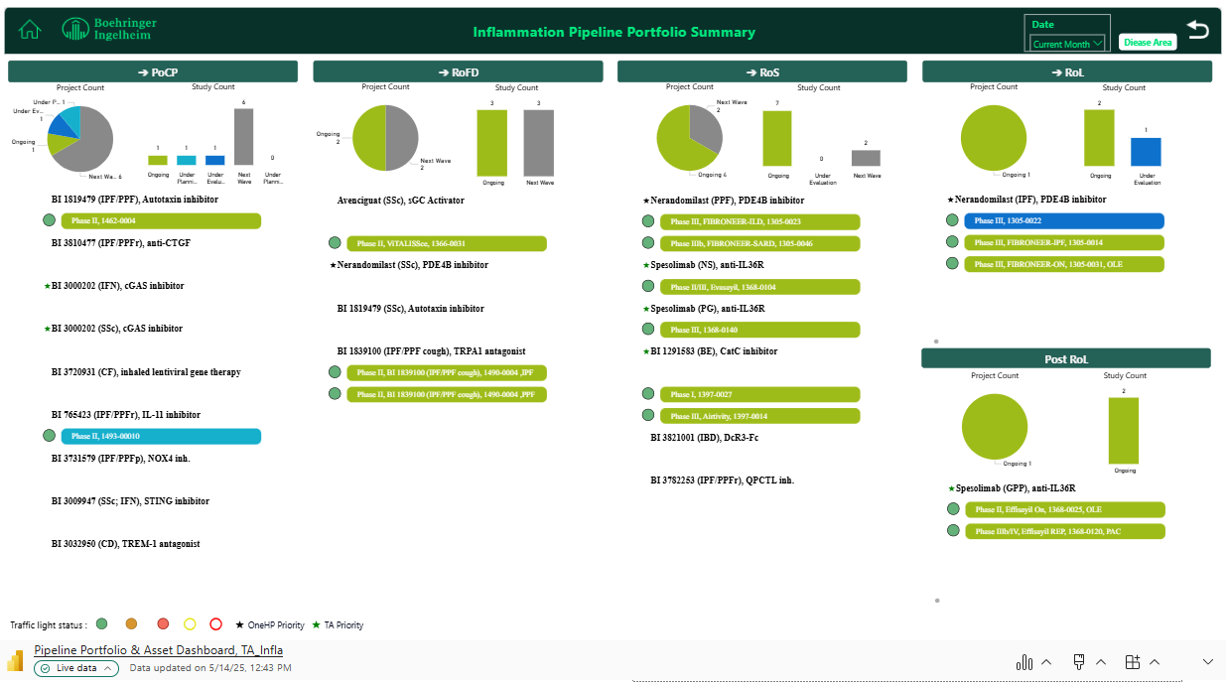
Title

Slide 3




2025 INFL TA Key Milestone Overview
Status May 14th, 2025:
All activities on track
Spesolimab NS
Ph2b/3 EVASAYIL topline results
Nerandomilast
FIBRONEER PPF topline
√
√
Nerandomilast
FIBRONEER PPF submission
Spesolimab NS
RoS
Nerandomilast IPF
RoL
√
Global milestones
Spesolimab PG
Ph3 CAPSAYIL initiation
Nerandomilast FIBRONEER PPF
RoS
Spesolimab NS Submission
√
√
Achived in Jan 2025
Jan 2025
Feb 2025
Mar 2025
Apr 2025
May 2025
Jun 2025
Jul 2025
Aug 2025
Sep 2025
Oct 2025
Nov 2025
Dec 2025
China milestones
Nerandomilast
PPF pre-NDA meeting request submission
Spesolimab NS
BTD & pre-NDA
discontinued
TRPA1 inh.
Ph2 IPF LSR
Nerandomilast IPF NDA submission
√
CatCi
1st site activation
CatCi
FPFV & FPI & FPFT
√
Nerandomilast
FIBRONEER-ON Ph3 last patient roll-over
Nerandomilast
chILD ph3 HAI meeting request submission (postponed TBU)
Nerandomilast
chILD Ph3 1st SIV
√
CatCi
Investigator meeting
Nerandomilast
chILD Ph3 CTA submission
CatCi
CTA submission
√
Nerandomilast
FIBRONEER-SARD Ph3b 1st SIV （on-hold, TBU)
CatCi
HGRAC submission
NOX-4 inh.
Ph2 early ILD CTA submission (on-hold, TBU)
Autotaxin inh.
Ph2 IPF LSR
√
cGAS
Ph2 INF CTA submission
Spesolimab PG
Ph3 SIV
CatCi
EC submission
Spesolimab NS
sNDA submission
discontinued
√
√
Nerandomilast
PPF NDA submission
√
Gastroenterology
Rheumatology
Study start/ read-out
Termination
Milestone
Dermatology
Pulmonology
Placeholder, under further evaluation
Notes:
Updated by eAL
Global milestone: SoD, PoCP, PoCC, RoFD, RoS, program termination, TLR
China milestone: CTA submission, 1st SIV, last patient randomization, NDA submission, NDA approval
Color coded by disease area or other criteria applied

Slide 4
Decisions/Advice provided by TA-CEC March - May 2025
Topic | Background | TA-CEC Decisions/Advice | Next steps/ Updates
cGASi early integration plan for CEC endorsement | BI 3000202, a cGAS inhibitor, is currently in clinical development (Ph1c of IFNopathy) to be approved to treat IFNopathy (US launch: Jun2032) and SSc (US launch: Dec 2034) in future. PoCP will be achieved in Jul 2026 (after Ph1c). Ph2 DRF study will be conducted in IFNopathy and SLE patients. Ph3 will be conducted in IFNopathy and SSc patients. April 8th: TALC endorsed to perform a Ph2 DRF in SLE subjects to support future ph3 study in SSc. As SLE is not a rare disease, and BI3000202 is a small molecule, team made the evaluation that the feasibility for backload PK study is moderate to low. To save time, Japan team would like to perform the HAI in parallel with PK CTP generation (endorsed by JPN management on Apr 11th). China team presented the early integration strategy and plan for the two ph2 studies (IFNopathy and SLE). | CEC endorsed CDE interaction plan for the ph2 studies of IFNopathy and SLE in Apr’s CEC meeting. CEC endorsed the integration plan of IFNopathy in Apr’s CEC meeting. CEC endorsed the early PK strategy and integration plan for SLE ph2 study in May’s CEC meeting. | Communicate with global team on the integration plan of the asset.
China integration plan and HAI for Nerandomilast in chILD (1305-0022, ph3) - for endorsement | Unmet Needs in chILD: Complex and heterogeneous spectrum of rare respiratory disorders. No approved therapies for fibrosing ILD in children in China. According to preliminary site feedback, significant challenges for China in recruiting patients due to limited patient pool, complex study procedures, and potential poor adherence to minitablets. The proposed China sample size is at least 1 CN patients from 5 sites in 21-month recruitment window. HAI prior CTA was recommended by CDE regarding CN integration plan and minimum sample size. Local AT has reached an agreement on the overall China integration strategy. Given the extremely small patient pool in China, the commercial launch of chILD indications will be further evaluated after gaining a better understanding of the market. | CEC endorsed that China synchronously joins the clinical development of Nerandomilast in chILD. CEC endorsed China HAI timeline (meeting request submitted in May) and the question list: 1) Does CDE agree that the current available non-clinical and clinical data supports China join the global pediatric trial 1305-0022? 2) Does CDE agree with the minimum sample size for Chinese pediatric subjects? Information update after CEC meeting: US HAI meeting request with FDA was denied due to lack of resources in FDA, HAI will be delayed for at least 6 months. As the TDO is expected to be completed by the end of June, the China HAI has been postponed, and the meeting request will be submitted when global core content is ready. | China HAI meeting request submission when global core content is ready.

Slide 5
TA Key Update (non-portfolio)
  PF
          5 RAB meetings have been held successfully in April to collect KEE feedback on data of FIBRONEER IPF results and treatment strategy based on PhIII data. ~60 KEEs were consulted.
          1 TTT and 1 Sponsorship were executed to emphasize the value of early diagnosis and early treatment of IPF/PPF for patients, 258 HCPs were covered.
          Fibroneer-IPF DBL2 & Fibroneer-ILD medical foundation training has been successfully held on 7th May, near 60 medical and cross-functional colleagues joined the training .
          IPF-patient survey(ECR 1199.0562), phase 1 CTR was completed by investigator and under BI internal view.
          ILD EPI study(ECR_ 1305-0111) protocol was finalized in Apr.
          1 MTA of nera poster by Prof. Qiao Ye was accepted by ATS as oral.
          1199-0434 study result was accepted by ATS as poster (Prof. Huaping Dai).
          The publication kick-off meeting of Fibroneer-PPF East-Asian population was successfully held by Chinese team on 8th May and 10 international top experts from 6 countries joined the meeting and shared their valuable insights.
          Both Fibroneer-IPF and PPF Chinese population abstracts first draft development were completed and are under internal and external review, target congress CTS 2025.
Dermatology
China GPP pediatric consensus was published in Apr which is the 1st GPP pediatric consensus globally, guiding pediatric GPP diagnosis and treatment standardization. Spesolimab was recommended as 1st line treatment in the GPP pediatric consensus.
3 Speso case reports were published in Apr covering PG, SAM syndrome and refractory GPP.
Providing scientific support to IL-36 treatment consensus development which will be published soon.
PG LRR 36 review was successfully completed.
MSL co-visit with CD&O to accelerate PG PhIII study enrollment.
2 internal training were provided to sales team.

Slide 6
TA Portfolio Key Update Late-stage Assets
One HP Priority
TA Priority
Asset Name (MoA) | Indication | CN Approval base case） | Update (please include key achievements, issues/risks, and etc.) | Next Step
Spesolimab (IL-36R) | NS | TBD | Study results: neither the primary nor key secondary endpoint were met. terminate development of spesolimab in Netherton Syndrome (NS). | DBL plan on 19Sep2025, CTR plan on 19Dec2025. All site closed by 19Dec2025.
 | PG | May 2028 | 13 of the planned 15 sites selected. SSU (Site Start Up) ongoing. 12 sites initiated till 7th May2025. As of 9 May, in China, 3 subjects were screened, one subject under screening, 0 randomized subjects, and 2 screen failed; globally,22 subjects were screened, 7 subject under screening, 5 randomized subjects, and 10 screen failed | Continue trial conduction and accelerate enrollment
Nerandomilast (PDE4bi) | IPF | Feb 2026 (will be further evaluated in Q3 2025 with evolvement of QC testing and GCP inspection) | Regulatory update: 1. Preparation of the IPF Type III meeting dossier is underway and submission of the meeting request is targeted for the last week of May; 2. The China integration plan for chILD was endorsed by CEC in April, and the China HAI meeting request will be submitted when global core content is ready. Inspection update: CFDI inspection notification for selected sites is expected to be received in May. Local preparation is ongoing. TLR communication: The primary publication will be released during ATS, and the data will be disseminated locally in sync. Risk: regarding CMC DS (B2 vs. B3), no structured bridge data was provided in NDA dossier and CDE will request bridge data—has aligned with global to add clarifications into proactive response list for better defending B3. | Type III meeting request submission for dose amendment is planned by the end of May. NMPA on-site inspection conduct and response in May and June.
 | PPF | Mar 2026 (will be further evaluated in Q3 2025 with evolvement of QC testing and GCP inspection) | Regulatory update: 1. The priority review application for the PPF indication received a positive opinion from the CDE on May 8, and PR will be officially granted on May 16, making it the first PR granted globally; 2. China NDA submission achieved on April 30 (EU combined submission on April 29, US PPF submission on May 5). Trial update: 1. FIBRONEER-ILD: DBL2 achieved on April 28; TLR communication: 1. local TLR foundation training was completed on May 7; 2. The primary publication will be released during ATS, and the data will be disseminated locally in sync. | Re-evaluate FIBRONEER-SARD study timeline.
 | SSc | 2031 (To be updated) | Based on the SSc-ILD subgroup analysis from FIBRONEER-ILD, the SSc phase 3 trial is under development without waiting for the SSc-ILD phase 2b results. HAI before TDO finalization was planned in Q3 2025 and global CTA submission is planned for Q1 2026. | Preparation for HAI.

Slide 7
TA Portfolio Key Update Late-stage Assets
One HP Priority
TA Priority
Asset Name (MoA) | Indication | CN Approval （base case） | Update (please include key achievements, issues/risks, and etc.) | Next Step
BI 1291583 (CatC inhibitor) | BE | Mar 2030 | CatCi Phase III (1397-0014) Global 1st EC approval obtained from China leading site CHN001 (Huadong Hospital affiliated to Fudan University). CatCi Phase III (1397-0014) final country allocation released, the global target sample size are 1642 patients. China commitment 201 patients indicating as the TOP1 recruiter in the listing. A total of 523 sites has been allocated for this trial. China Commitment of 54 sites has not been reduced. | 60 WD for technical review in CDE for CTA for BI 1291583 (CatCi) phase III trial 1397-0014 in BE, target approval by the end of May. CMC interaction planned in early Jun2025, to have the CDE feedback in Aug/Sep2025. To kick off the preparation of China PK study CTP in Sep2025.
 | Pediatric trials | Mar 2030 (adults+adolescents) | POSITIVE feedback from CDE regarding CatCi pediatric development plan (12-＜18 years of age) in phase III (1397-0014) trial and China will join global adolescent trial. | Team will target to submit the CTA of adolescent trial in CatCi Phase III based on the content final protocol amendment (roughly in early July after translation), details will be shared after amendment timeline sticked.

Slide 8
TA Portfolio Key Update Early Assets
One HP Priority
TA Priority
Asset Name-MoA | Indication | China Approval (base case） | Update (include key achievements, issues/risks, and etc.) | Next Step
Avenciguat (sGC activator) | SSc | Jul 2031 | CDE feedback on Ph2 (1366-0031) IA plan received on 28 Apr: no further comments on IA plan Corporate final decision on 22 Apr: OLE study (1366-0032) following the ph2 study (1366-0031) will not be conducted in future as company will put limited resources on some prioritized projects. Global team are recently discussing whether it is possible to submit NDA by leveraging single ph2 data. | Local team will complete the global core meeting package (EoP2) by end of May Local team work closely with global by providing local inputs and requirements from CDE.
BI 1839100 (TRPA1 antagonist) | IPF/PPF cough | Jan 2032 | On 8Apr, China team successfully completed the target enrollment number (n=10) in IPF cohort of ph2 ahead of 8 months. (global TOP1 recruiter). China continue to contribute the subjects to global ph2, as of 13 May, China randomized 11 subjects (global TOP1 recruiter), 2 subjects in screening. | Continue to enroll the 2 subjects
BI 1819479 (Autotaxin inhibitor) | IPF/PPF | Feb 2032 | China completed the enrollment of all subjects on Jan 21(N=24), 11 months ahead of the plan. Update in May: PK sample (from ph2 study) exportation CIQ was obtained, onsite inspection was passed, flight was booked on 11-12 May. | Monitoring the PK sample exportation activities
BI 3000202 （cGASi） | IFNopathy SSc | Jun 2033 Apr 2035 | China team generated the CDE interaction plan for IFNopathy early integration plan for ph 2 of IFNopathy & SLE, and team got endorsement from CEC | Communicate with global team on integration plan

Slide 9
INFL TA PMS Study Overview-ILD
Substance/ MOA/Formulation | Indication | Study type (Study no.: FPI-LPO, CTR) | China Dev. Strat. | Current Status | Next Mile-stone | Key Updates
China IPF Registry Study (PORTRAY) | IPF | IIS (1199-0302) (Jul2018-July2026,July2027) | China alone | Follow up | LPO (July 2026) | Follow up ongoing. Subject follow-up rate is low LPT visited PI and her team on 16 Dec 2024. Got the alignment: There will be 2 publications, and Sub-I will contact the sub-sites to collect more subjects’ follow-up data as far as possible. Sponsor collected some supplement subject data from sub-sites: 153(+65) visits
A Prospective, Multi-Center Registry Study of Progressive Pulmonary Fibrosis (PPF) in China (PROFINA) | PPF | ECR (1305-0105) (Oct2025-Jul2028, Dec2028) | China alone​ | Protocol approval (Apr2025) | Contract approval (Sep2025) | PEC approval obtained on 28Feb2024 Proposal global approval (4th round) obtained on 12Nov2024. CRO "Heyuan Huifeng" was selected by PI on 31Oct. Onsite kick-off meeting conducted on 27Nov. Protocol finalized, signature obtained. EC approval obtained on 14Apr. Specific contract terms are under internal legal team discussion.
IPF SURVEY | IPF | ECR(1199-0562) (Sep2023-Jul2026) | China alone | Enrollment | LPI(phase II) (Dec2025) | Protocol approved 20Feb2024;EC approval 11Mar2024;Contract effective 5June2024;ALL (6)sites initiated. Phase I Enrollment completed. (Physician 15/15; patient 53/50) Ph1 report has been finalized on May 14. Phase II preparation
Serum Exosome Combined with Radiomics to Predict Early Progressive Pulmonary Fibrosis | PPF | ECR (1305-0123) (Dec2025-Dec2027, Jun2028) | China alone | Proposal approval (Jan2025) | Protocal approval (May2025) | Updated timeline and budget were endorsed by CEC on 13Sep.Hybrid review completed on 21Jan Proposal global release completed on 04Mar. Revised contract sent for site review, protocol under development by sponsor/investigator. Kick-off meeting time is under discussion with investigator.
ILD EPI study in China | NA | ECR(1305-0111) (May 2025- Aug 2025, Sep 2026) | China alone | Protocol approval (Apr 2025) | EC approval (May 2025) | CEC endorsed in Aug 2024. Hybrid review was completed on 15th Oct and global released with comments on 4th Dec. Kick off meeting was held on 24Dec 2024. Contract was completed on 14Mar 2025. Protocol was fully approved on 14Apr 2025.

Slide 10
PMS studies of Spesolimab
Substance/ MOA/Formulation | Indication | Study type/Global Status (Study no.: FPI-LPO, CTR) | China Dev. Strat. | Current Status | Next Mile-stone | Key Updates
Exploration of the pathogenesis of GPP and PV​ | GPP/PV​ | IIS(1368-0133) (Nov2023-Apr2024, Dec2024) | China alone​ | LSI (May 2025) | CTR (Dec 2025) | Enrolment was completed on May 16th CTR delay due to 1) site internal payment checkout process 2) analyst’s schedule 3) sample testing and adjusting CTR can be submitted by May as the investigator is making final revisions.
EPI study in HS PG | PG&HS​ | ECR​(1368-0167) (Nov 2026)​ | China alone​ | Contract sign-off (Dec 2024) | Data analysis of PG (Apr 2026) | Proposal release on 23Aug; Protocol was approved with minor comments on 21 Oct 2024; EC approved in Nov 2024 Contract was signed on 17 Dec 2024 Sponsor-collaborator has completed work butting with Beijing Big data center in Jan 2025 and now is checking data regularly
Mixed-Methods study for GPP | GPP | ECR (May2025-Q32027, Q42027) | China alone | CEC approval (Sep2024) | Proposal approval (Nov2024) | CEC endorsed in Sep 2024. Hybrid review was approved on 20th Nov. Global release is on hold because the global Spesolimab asset team that they were asked to pause all ECR (including local budget)releases due to ongoing budget discussions. There is not any confirmation of this study. Study team plans to update the study timeline after release.

Slide 11
Backup

Slide 12
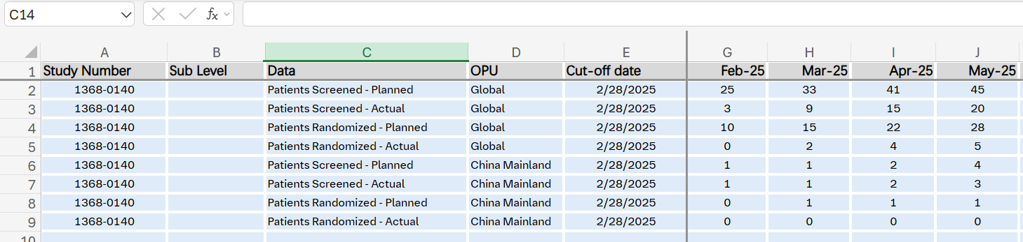

Project
Total Screened = 20
In Screening = 9
Total Randomized = 5
SF rate = 30%（6）
Data captured from OMP portal

Slide 13
Project
Total Screened = 3
In Screening = 1
Total Randomized = 0
SF = 67% （2）

Slide 14
Accelerate PG Ph III study enrollment
Site initiation
1st SIV： 15Jan2025
First Patient Screened：20Feb2025 ( Totally 1 patient screened, 1 in screening)
9 out of 13 sites initiated till 24March2025. (75% Site Initiation by 15Apr2025;100% Site Initiation by end of Q2 2025)
Recruitment Challenge
Rare disease
Difficult for PG diagnosis
Complex treatment background for PG pts
Potential patients from different sites departments (patient source uncertain)
Low awareness ​
Placebo trial design ​
Potential Patient status stable ​
Potential Patient willingness low ​
Action plan
2025 |  |  |  | 2026
Q1 | Q2 | Q3 | Q4 | Q1 | Q2
Last patient Randomized Apr2026
CD & O
Co-visit for SIVs
(by CTM and Local Physician)
Advertisements (by Sites & subsidiary hospitals)
Weekly Newsletter delivery
Pre-screening for potential patients (by sites)
Interim IM
CRA Workshop
MSLs
MSL Training
MSL Activities (site engagement and referral mapping)
√
HCP and Patient Trial Materials
Trial Awareness @ congresses (Derm, GI, Rheum, Wound Care)
Co-visit for sites
Monthly meeting with CD&O to share medical insights
CFT
leverage by PAG support
We are here
Media Outreach

Slide 15
PG clinical trial related insights from Chinese PI (Prof. Wenhui WANG)
Placebo group allowed only 20 mg/d steroid treatment in first 26 weeks, which is often insufficient to control PG progression. This may reduce patient enrollment intention.
Mild PG cases treated with topical or low-dose oral JAK inhibitors may achieve complete remission and thus might not require enrollment in this clinical trial. The patients enrolled are typically more complex cases, making it important to: 1) evaluate the therapeutic efficacy of Spesolimab in this population, and 2) consider that placebo allocation could pose significant challenges for these patients who often require active treatment.
Peking University Third Hospital’s treatment goal for PG is “onset of effect in 1 week and healing in 8 weeks.” The primary endpoint of this clinical trial is assessed at week 26, which is later than the hospital’s treatment goal and may lead to a decreased confidence in Spesolimab efficacy.
In the inclusion and exclusion criteria, the requirement for the target ulcer area of PG to be 5-80 cm² has a relatively narrow range, which may exclude some patients.
Peking University Third Hospital adopts a “ 0 Corticosteroid ” treatment regimen for PG, generally using JAK inhibitors, which show efficacy within one week, with improvement of skin lesions and pain. If the effect is not satisfactory, adalimumab is used, which can achieve favorable outcomes.
Wound care is essential for all PG patients, and the timing of debridement and skin grafting is crucial. Debridement and skin grafting are usually performed during the non-active phase to promote ulcer healing; if in the active phase and the ulcer site has poor growth of new tissue, debridement can also be cautiously implemented, which can also help ulcer recovery.
These insights have already be shared with the global evidence lead of Spesolimab(Thoma,Dr.,Christian), the clinical project lead for PG ( Elgadi, Dr. Mabrouk), Medical advisor of TA Med Affairs (Semeco,Dr.,Juan)

